Slide 1
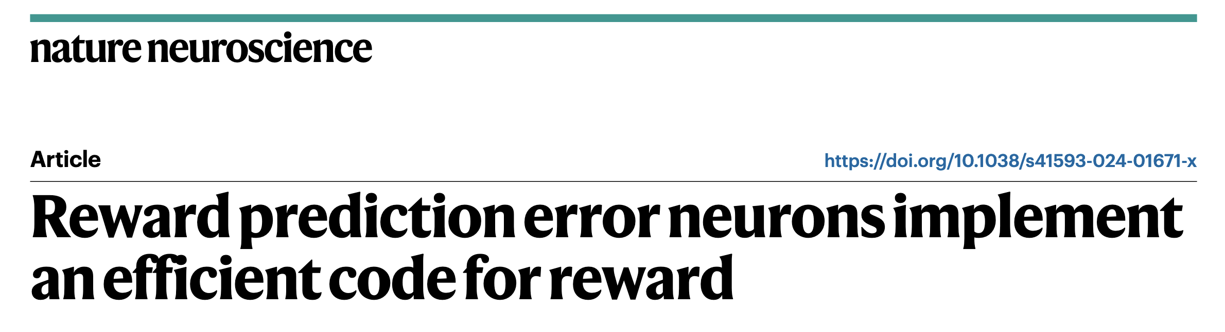
Authors: Heiko H. Schütt, Dongjae Kim, Wei Ji Ma
Presented by Snow

Slide 2
Efficient Coding
sensory neuroscience
neuronal codes are optimized for efficiency, that is, to convey as much information as possible with given budgets for the number of neurons and the number of action potentials

Slide 3
Efficient Coding
sensory neuroscience
neuronal codes are optimized for efficiency, that is, to convey as much information as possible with given budgets for the number of neurons and the number of action potentials
reward
Reward Prediction Error Neurons? (RPEN)

Slide 4
Overview
1. Derive the efficient code
2. Efficient code satisfies properties of real neurons
3. How do neurons learn the tuning? Distributional RL

Slide 5
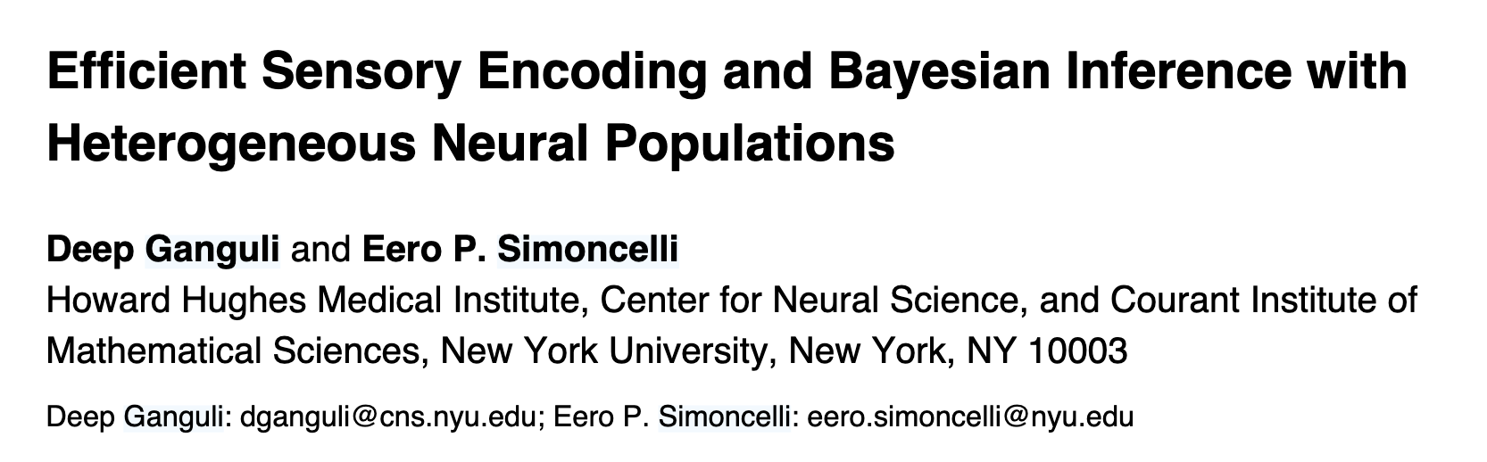
Overview
1. Derive the efficient code
with some modifications

Slide 6
Overview
1. Derive the efficient code
Main idea: Optimize Fisher Information(with certain constraints)

Slide 7
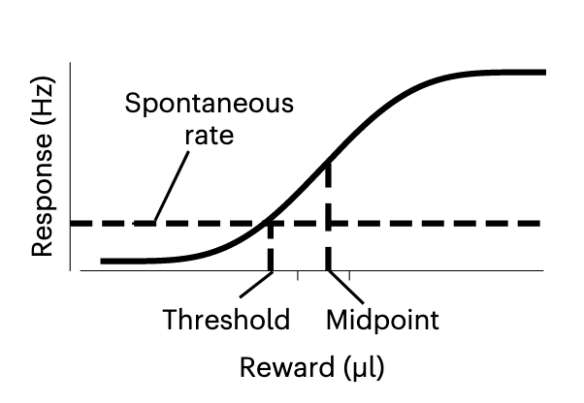
Efficient Code computation
half the maximal response
RPEN’s sigmoid tuning curve
Notes:
spontaneous rate, not starting with reward=0?

Slide 8
Efficient Code computation
What are the elments of a population coding?
(given N neurons)
half the maximal response
Tuning curves(response functions)
(assume they are the same w.r.t. given midpoint=μ)
Density of neurons with midpoint=μ
Regularization:Mapping from reward to unit interval
RPEN’s sigmoid tuning curve

Slide 9




Efficient Code computation
half the maximal response
Response function, midpoint = μ
Reward mapping
A prototypical sigmoidal function
Neural Gain as a function of
RPEN’s sigmoid tuning curve

Slide 10
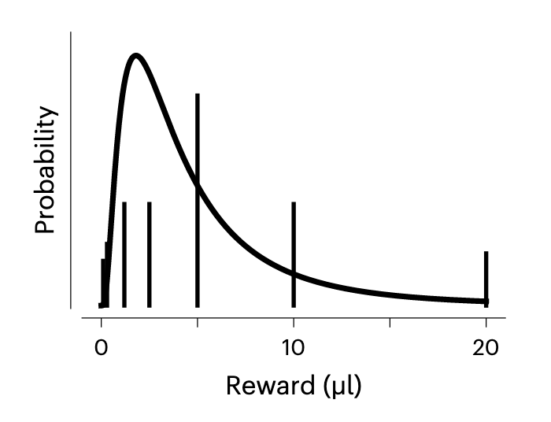
Efficient Code computation
Problem of efficient code:
What is the most efficient population to encode the reward stimuli?

Slide 11

Efficient Code computation
Problem of efficient code:
Given
What is the most efficient population to encode the reward stimuli?

Slide 12
Efficient Code computation
Problem of efficient code:
Fisher Information
Given
maximize
What is the most efficient population to encode the reward stimuli?

Slide 13
Efficient Code computation
Problem of efficient code:
Fisher Information
Given
maximize
under
constraints:
upper bound to the expected number of spikes
What is the most efficient population to encode the reward stimuli?

Slide 14

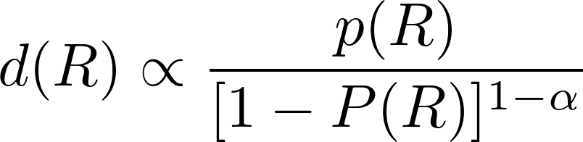
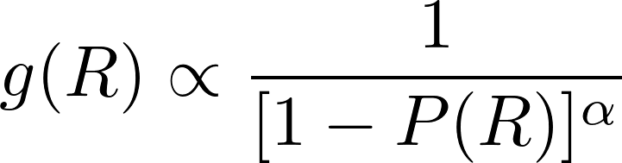


Efficient Code computation
Problem of efficient code:
Fisher Information
Given
maximize
under
constraints:
upper bound to the expected number of spikes
is a free parameter,
What is the most efficient population to encode the reward stimuli?

Slide 15
Efficient Code computation
Zoom back into a single neuron:
these results are independent of the exact shape of the sigmoid tuning curves(h0)
is a free parameter,

Slide 16
Efficient Code computation
Zoom back into a single neuron:
slope k; spontaneous firing rate r*
we fit these two parameters:
minimize MSE of thesholds
(between efficient code and measured neurons)
c.d.f. of beta distributions as the sigmoid response functions
Notes:
set k different or same for all neurons?

Slide 17
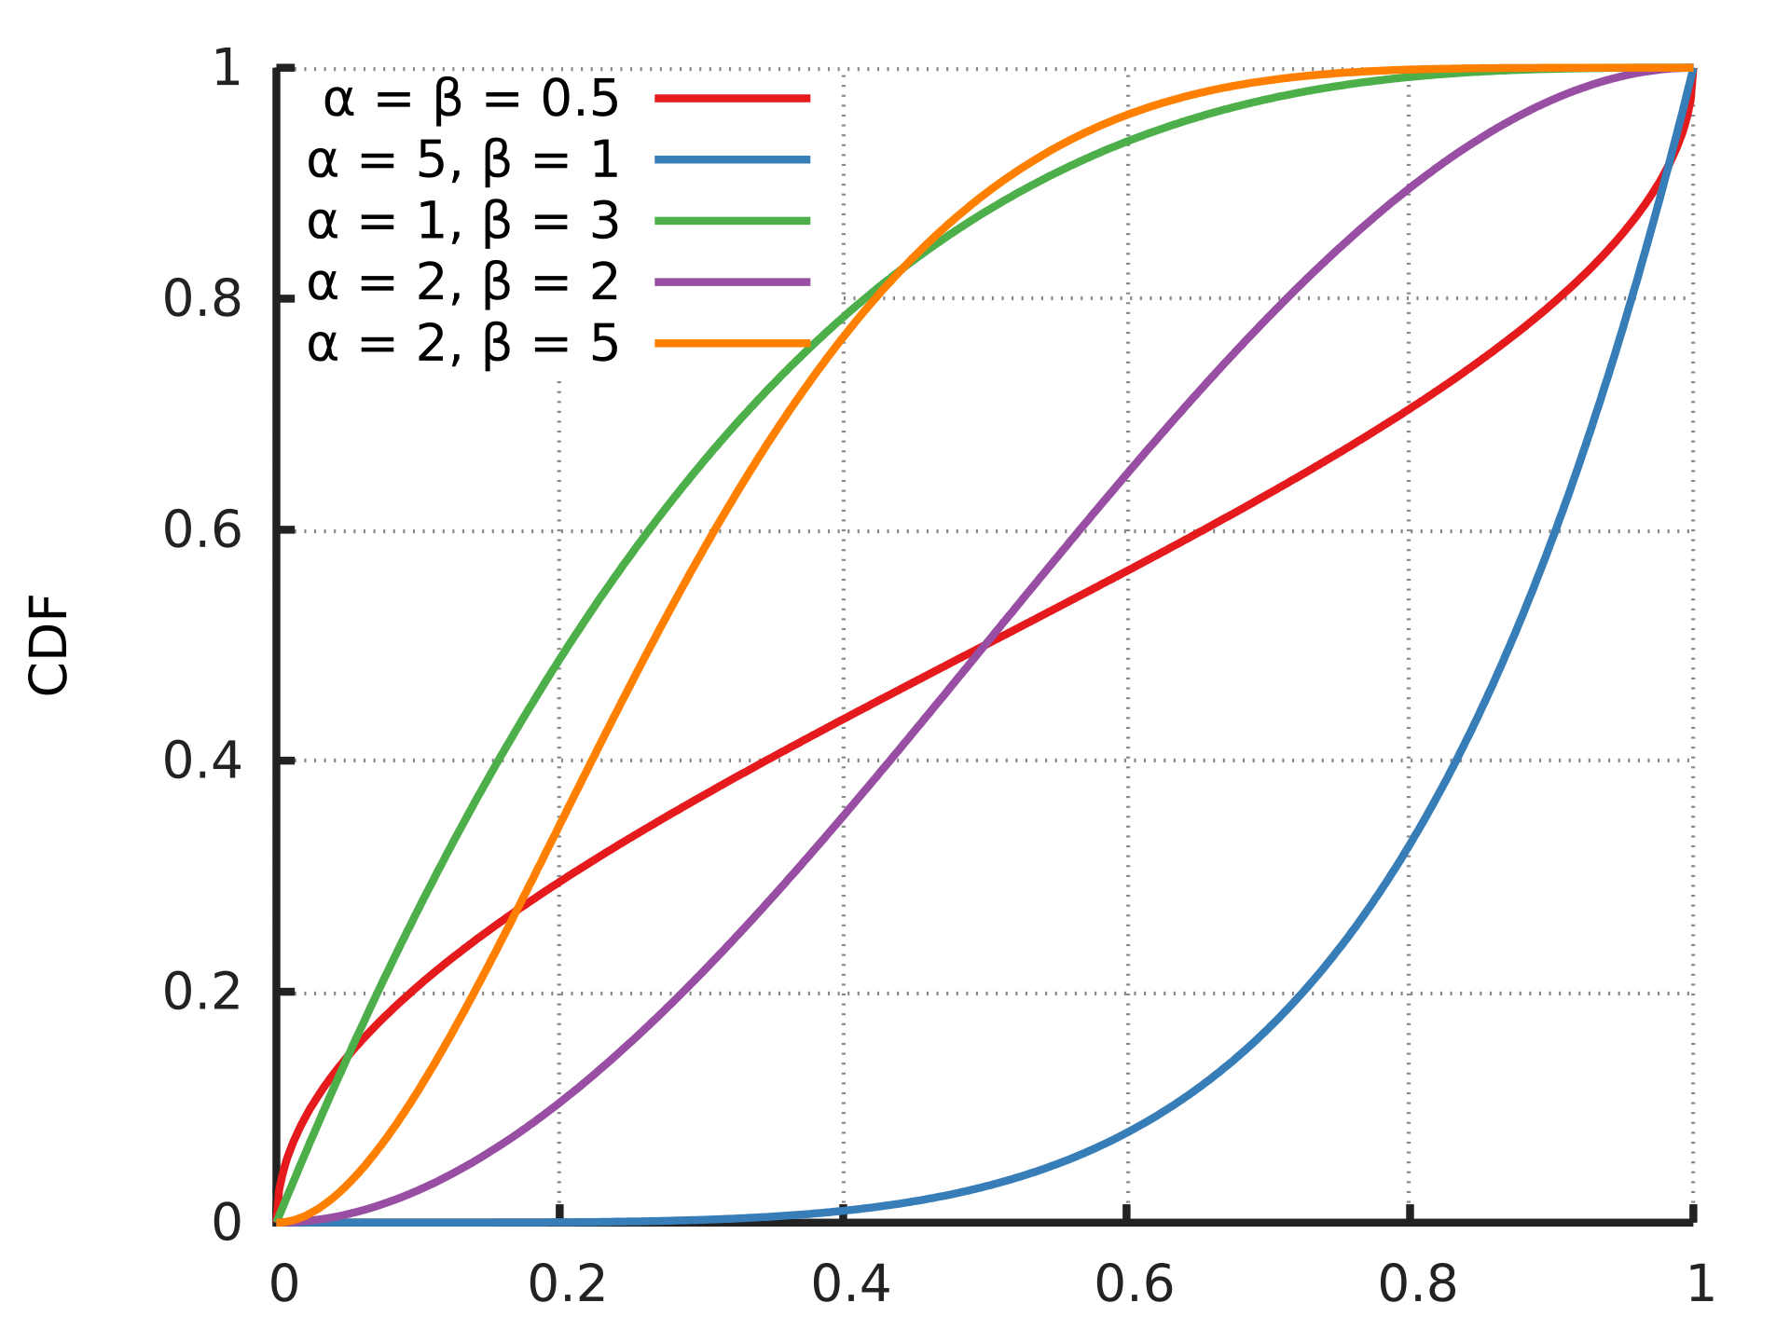
Cumulative Distribution Function of Beta Distribution

Slide 18
Efficient Code computation
Zoom back into a single neuron:
c.d.f. of beta distributions as the sigmoid response functions
beta distribution is parameterized by a, b
for a neuron with slope k, midpoint p
set a=kp, b=k(1-p)
good boundary behavior

Slide 19

What’s new?
a special case:

Slide 20
Overview
1. Derive the efficient code
2. Efficient code satisfies properties of real neurons
3. How do neurons learn the tuning? Distributional RL

Slide 21
Application 1: variable-reward task
reward condition:
Eshel et al.
vertical bars: seven values of reward with probability
smooth curve: fitted moment-matched log-normal distribution

Slide 22
Application 1: variable-reward task
Data & Model fitting

Slide 23
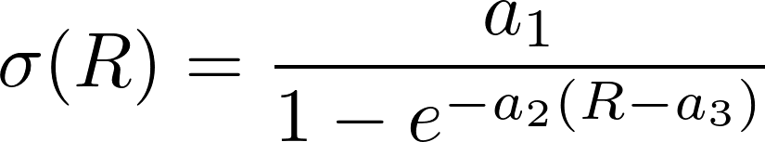
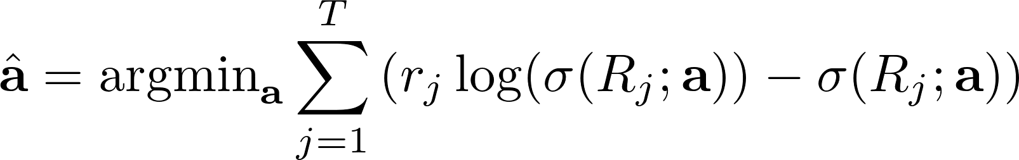

Application 1: variable-reward task
Data & Model fitting
Step 1: Fitting Logistic sigmoid functions to measured neurons
maximum-likelihood estimation based on Poisson noise
where

Slide 24
Application 1: variable-reward task
Data & Model fitting
Step 2:
is a free parameter,

Slide 25
Application 1: variable-reward task
Data & Model fitting
Step 2:
maximize the probability of the observed midpoints

Slide 26

Application 1: variable-reward task
Data & Model fitting
Step 2:
maximize the probability of the observed midpoints

Slide 27
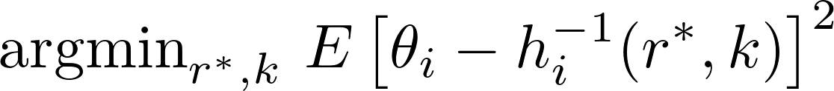
Application 1: variable-reward task
Data & Model fitting
Step 3: slope k; spontaneous firing rate r*
minimize MSE of thesholds
(between efficient code and
measured neurons)

Slide 28
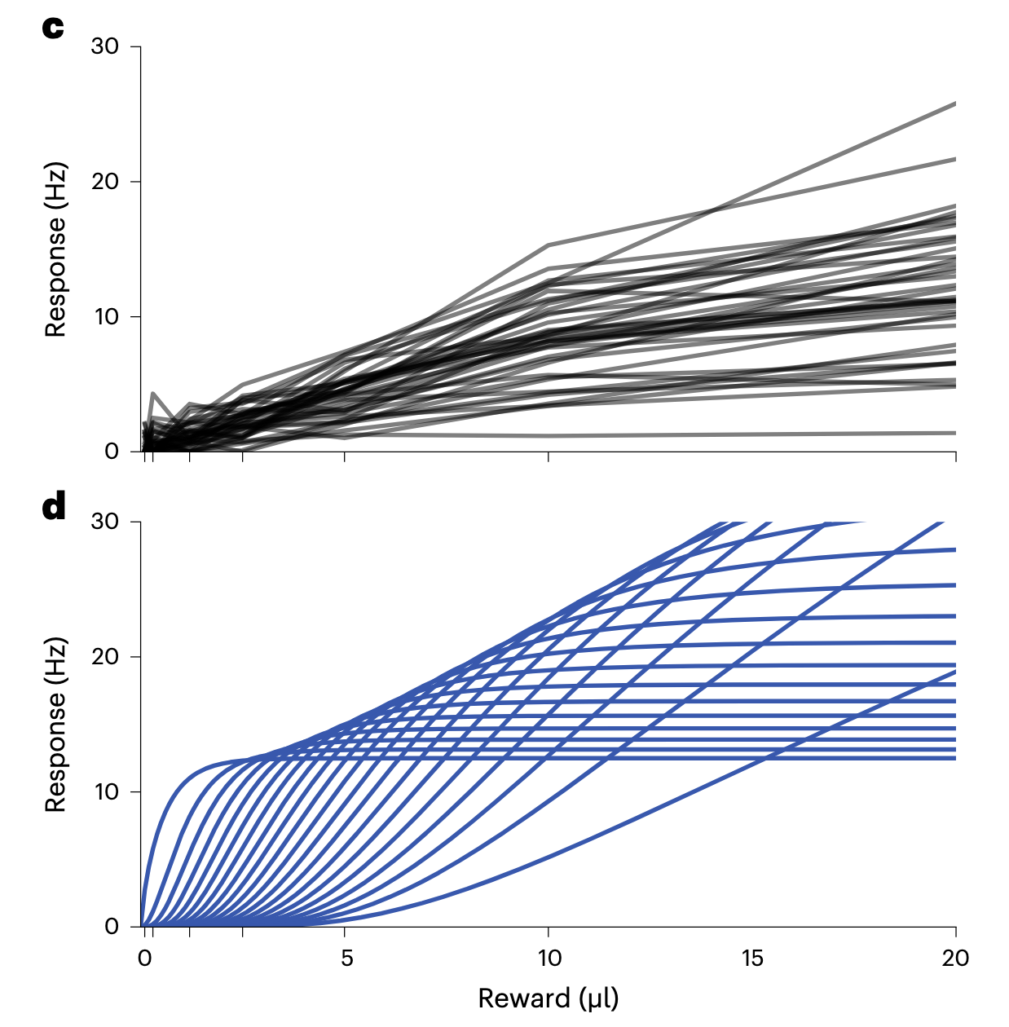
Application 1: variable-reward task
39 dopaminergic RPENs measured by Eshel et al.
(preprocessed)
Efficient code

Slide 29
Application 1: variable-reward task
Predictions:
RPEN midpoints cover the reward distribution
RPEN gain increases with threshold
RPEN tuning curve asymmetry flips with increasing threshold
RPEN slope decreases with threshold
My question: Why *these* predictions?

Slide 30
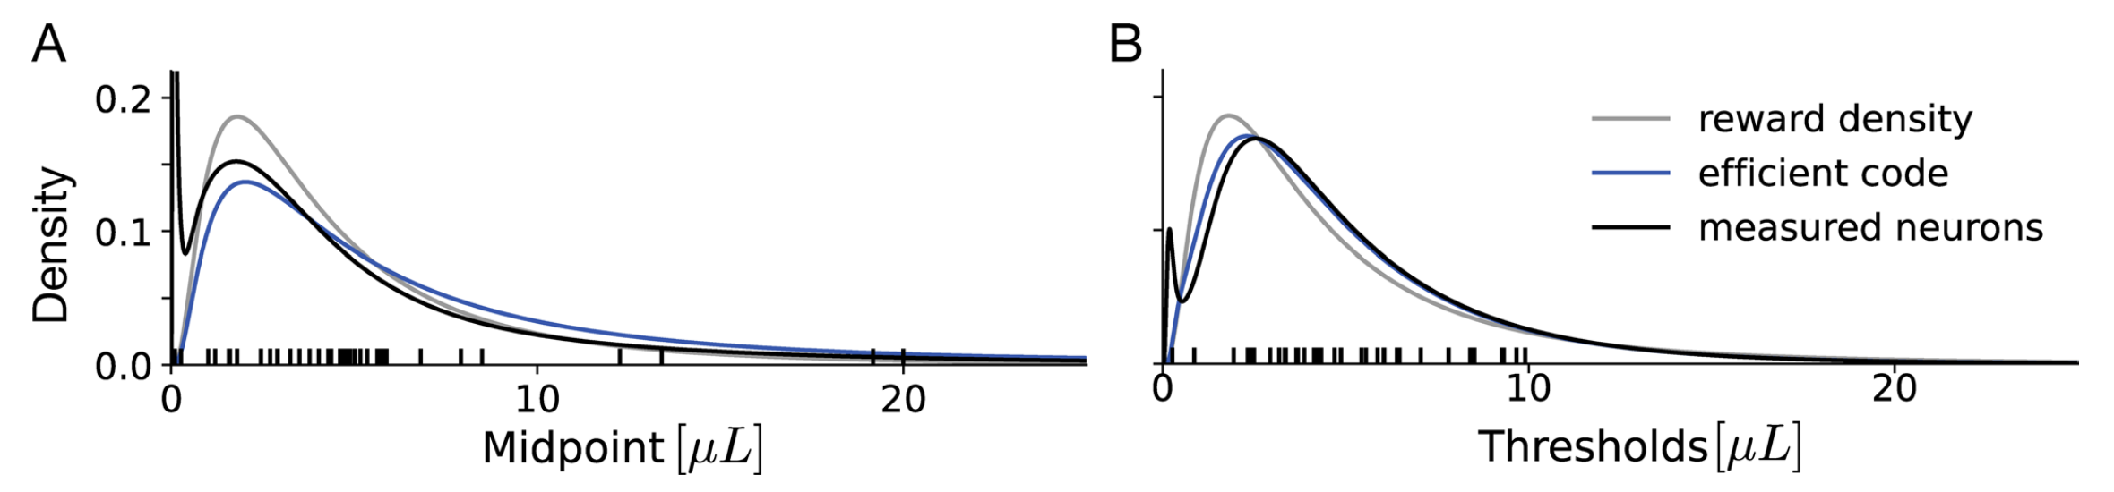
Application 1: variable-reward task
Predictions
Prediction 1: RPEN midpoints cover the reward distribution
difference not significant

Slide 31
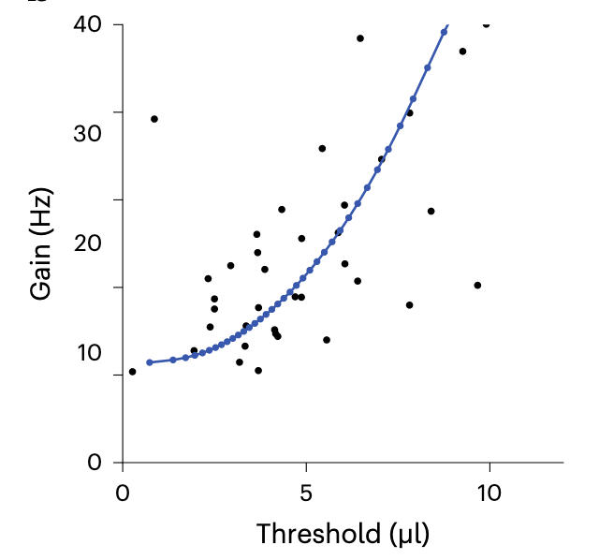
Application 1: variable-reward task
Predictions
Prediction 2: RPEN gain increases with theshold
with same expected number of spikes:
higher theshold→respond to fewer rewards
                ↓
          afford a higher gain
significant positive relationship
Blue: Efficient code
Black: Measured neurons
this empirical finding has not been reported before

Slide 32
Application 1: variable-reward task
Predictions
Prediction 3: RPEN tuning curve asymmetry flips with increasing theshold
increase the gain
lower theshold
Threshold

Slide 33
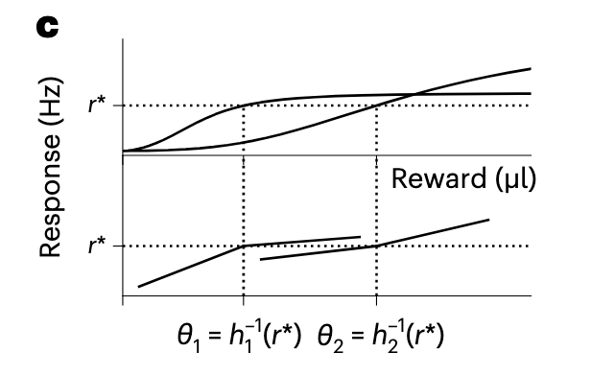
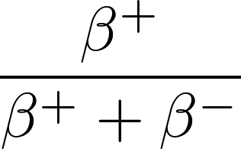
Application 1: variable-reward task
Predictions
Prediction 3: RPEN tuning curve asymmetry flips with increasing theshold
Degree of asymmetry:
slope above theshold
slope below theshold
Fit two linear response functions
(following Dabney’s work)

Slide 34
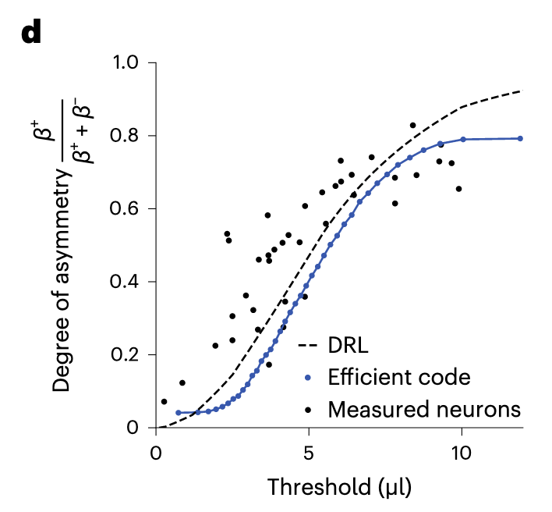
Application 1: variable-reward task
Predictions
Prediction 3: RPEN tuning curve asymmetry flips with increasing theshold
strong positive relationship

Slide 35
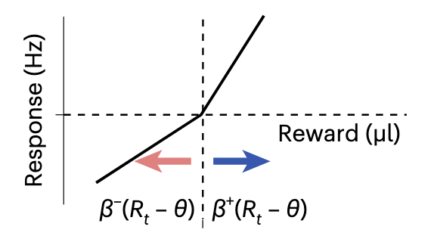
Application 1: variable-reward task
Predictions
Prediction 3: RPEN tuning curve asymmetry flips with increasing theshold
What is the meaning of asymmetry here?

Slide 36
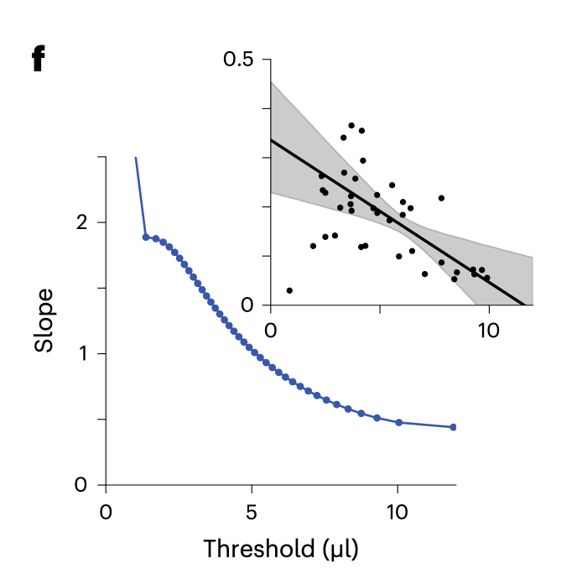
Application 1: variable-reward task
Predictions
Prediction 4: RPEN slope decreases with theshold
significant negative linear relationship
response functions are shallower in regions with
lower reward density
(⟹cover broader reward ranges with fewer neurons)
Blue: Efficient code
Black: Measured neurons
this empirical finding has not been reported before

Slide 37
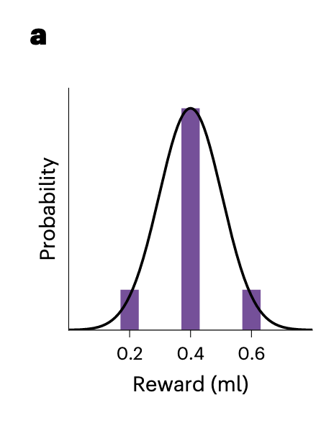
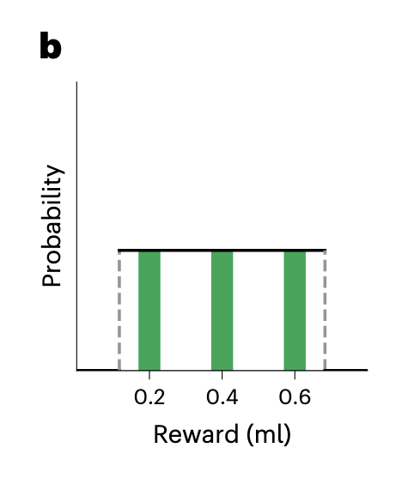
Application 2: variable-distribution task
Rothenhoefer et al.
reward condition:
‘normal’ distribution
‘uniform’ distribution
(with the same mean)

Slide 38
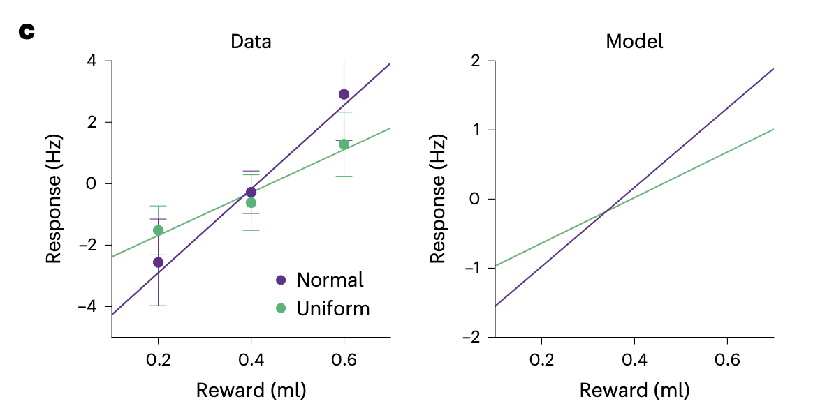
Application 2: variable-distribution task
main finding of Rothenhoefer et al. :
example neurons
steeper response functions for ‘normal’ than ‘uniform’
(dopamine responses are amplified for rare rewards)
Notes:
Model: Efficient code
dopamine responses are amplified for rare rewards: for normal distribution, high rewards are rarer, leading to a higher response hence higher slope

Slide 39
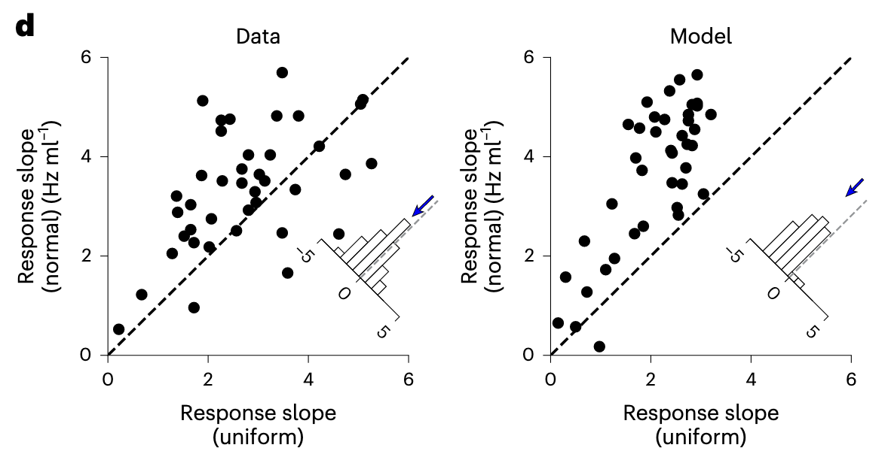
Application 2: variable-distribution task
all neurons
steeper response functions for ‘normal’ than ‘uniform’

Slide 40
Overview
1. Derive the efficient code
2. Efficient code satisfies properties of real neurons
3. How do neurons learn the tuning? Distributional RL

Slide 41
Reinforcement Learning

Slide 42
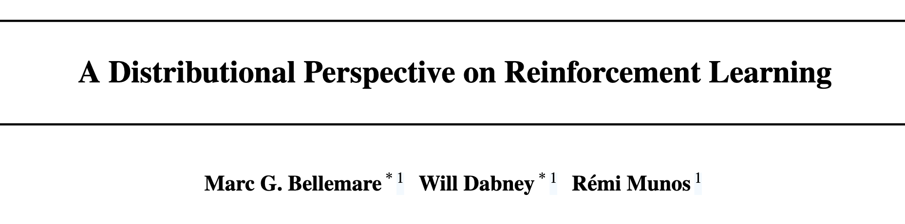
Distributional Reinforcement Learning
↓
random variable instead of an expected value

Slide 43
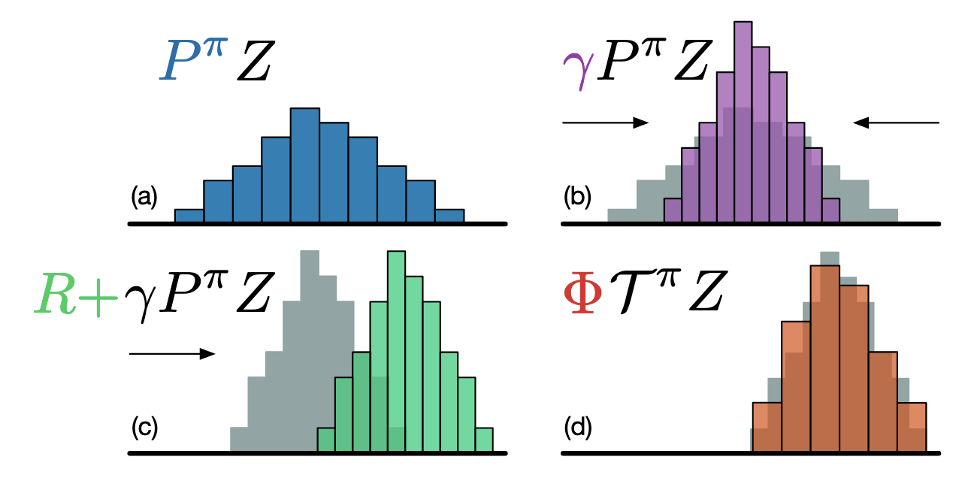
Distributional Reinforcement Learning
Notes:
乘gamma：想象推一堆沙子

Slide 44
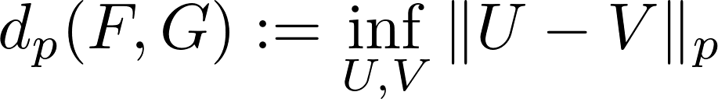
Distributional Reinforcement Learning
The Wasserstein Metric
calculate the distance between two distributions

Slide 45
Distributional Reinforcement Learning
How to implement in tasks?

Slide 46
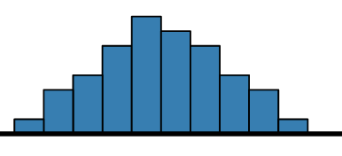
Distributional Reinforcement Learning
How to implement in tasks?
Approximate the distribution(continuous) with a discrete set of parametrized value functions
“highly expressive and computationally friendly”

Slide 47
Distributional Reinforcement Learning
projection onto the support

Slide 48
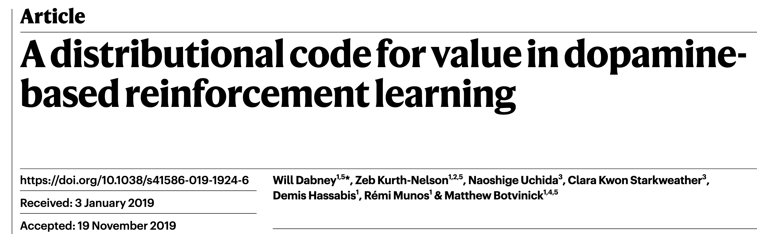
DRL in dopamine neurons

Slide 49





DRL in dopamine neurons
For each value function , prediction error:
State x
Asymmetry update rule:
State x’

Slide 50
DRL in dopamine neurons
where f is a function that transforms the prediction error

Slide 51


DRL in dopamine neurons
take
$$f(x)=sign(x)$$

Slide 52
DRL in dopamine neurons

Slide 53
DRL in dopamine neurons
upper quartile of the distribution
State x’

Slide 54
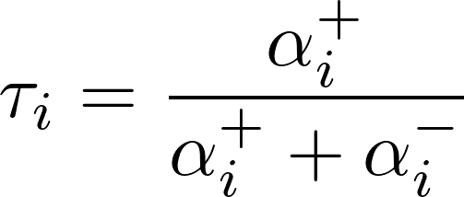
DRL in dopamine neurons
State x’

Slide 55
Application 1: variable-reward task
Predictions
Prediction 3: RPEN tuning curve asymmetry flips with increasing theshold
What is the meaning of asymmetry here?

Slide 56
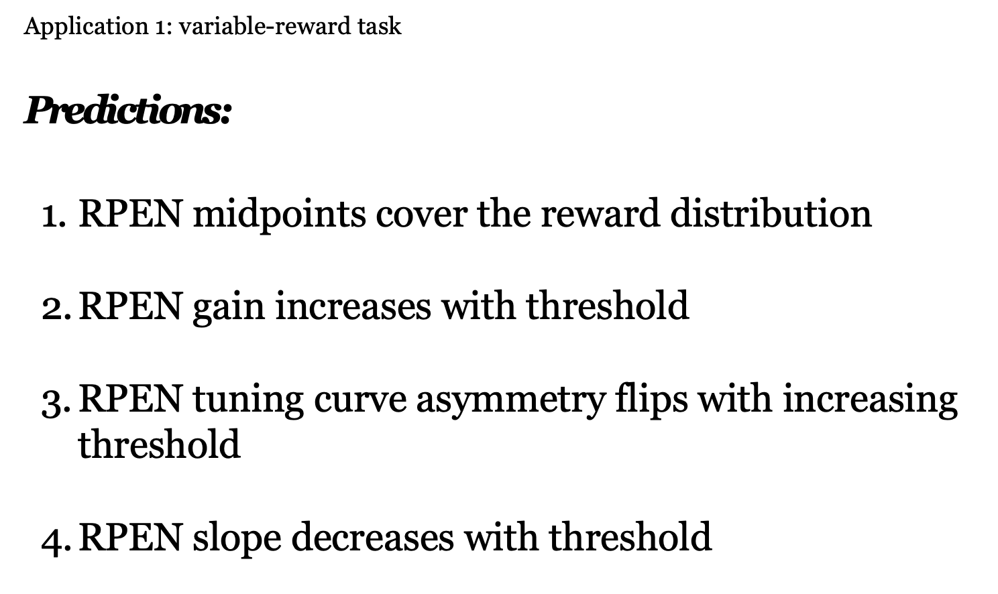
Learning rules for the efficient code
Quantile learning
Slope learning
Gain

Slide 57
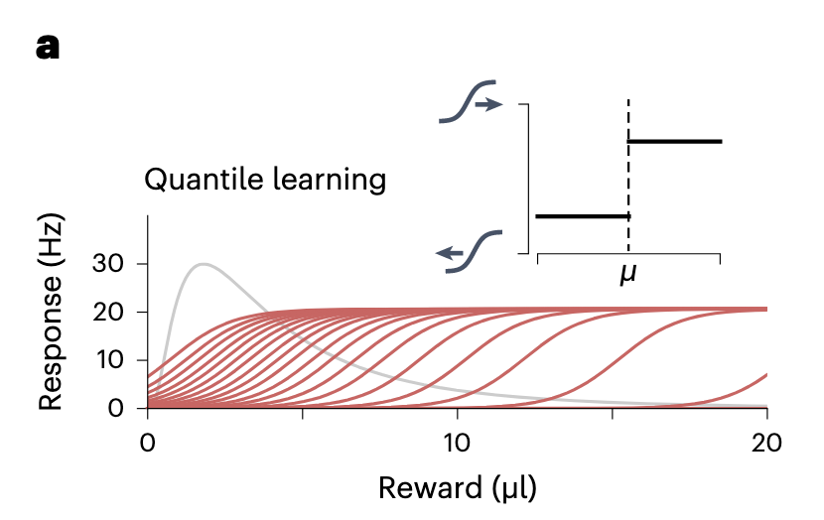
Learning rules for the efficient code
Quantile learning
If reward > midpoint, shift the curve to the right, step size = b
If reward < midpoint, shift the curve to the left, step size = a
converge to the p th quantile of the reward distribution
where ap = b(1 - p)

Slide 58
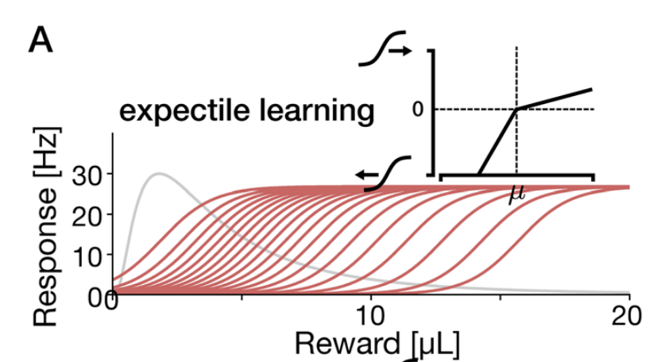
Learning rules for the efficient code
Expectile learning
If reward > midpoint, shift the curve to the right, step size = b * prediction error
If reward < midpoint, shift the curve to the left, step size = a * prediction error

Slide 59
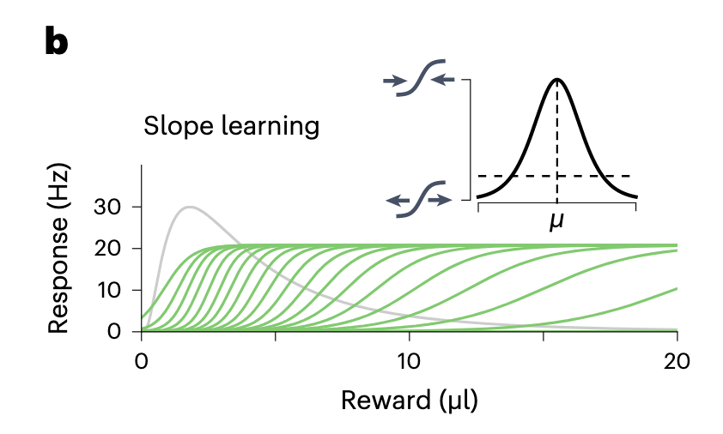
Learning rules for the efficient code
Slope learning
In the efficient code, the RPEN slope should be proportional to the local probability density of rewards

Slide 60
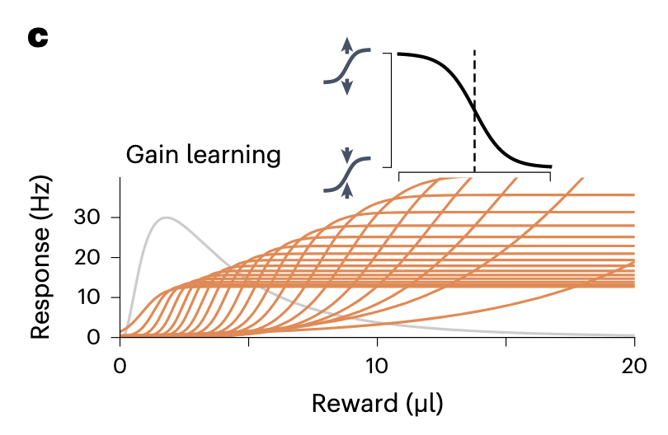
Learning rules for the efficient code
Gain Method 1
Gain learning
Notes:
work similarly well but that are based on different biological mechanisms

Slide 61
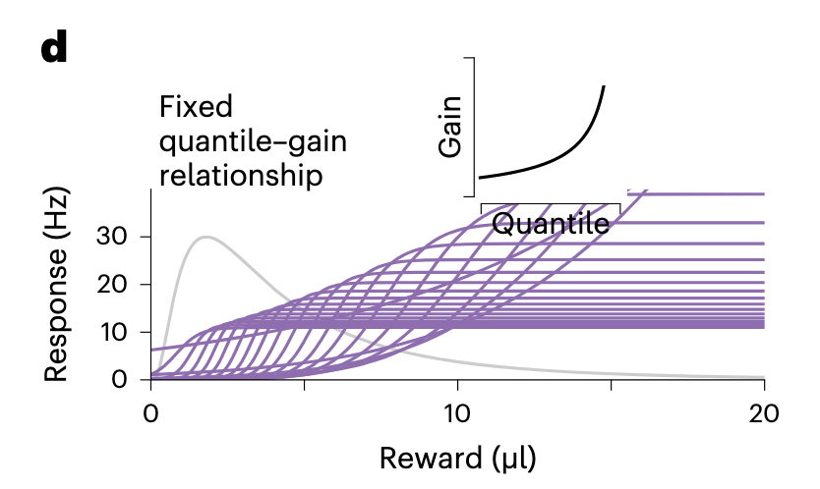
Learning rules for the efficient code
Gain Method 2
Fixed gain per neuron, determined by quantile

Slide 62
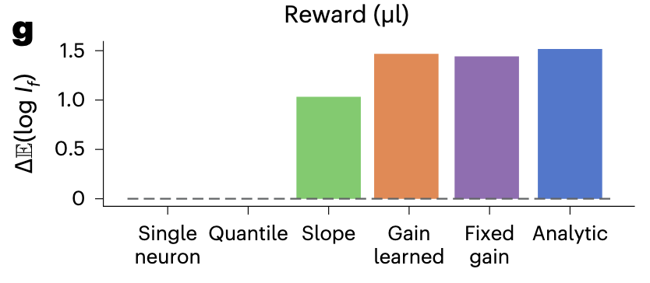
Learning rules for the efficient code
Comparison

Slide 63
Efficient Code computation Details

Slide 64
Efficient Code computation
We start by defining a ‘standard’ population of RPENs

Slide 65
Efficient Code computation

Slide 66
Discussion
Task design: No action required by the animal
the reward received and the change in value of the current state are confounded
Notes:
we were able to account for five empirical findings across two tasks

Slide 67
Discussion
half the maximal response
Response function, midpoint = μ
Reward mapping
A prototypical sigmoidal function
Neural Gain as a function of
RPEN’s sigmoid tuning curve
We assumed that every neuron with a midpoint = μ is the same.

Slide 68
Discussion
In classical reinforcement learning, we set the same learning rate for negative PE and positive PE.
What about setting two different ones respectively? Would that help in better fitting behavioral data, or extract some latent variables for further analysis?
Notes:
we were able to account for five empirical findings across two tasks

